Slide 1




Alec Steinwall
Notes:
Brief introduction to the school

Slide 2


Slide 3
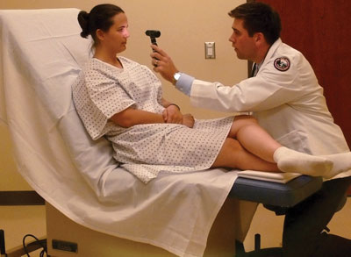
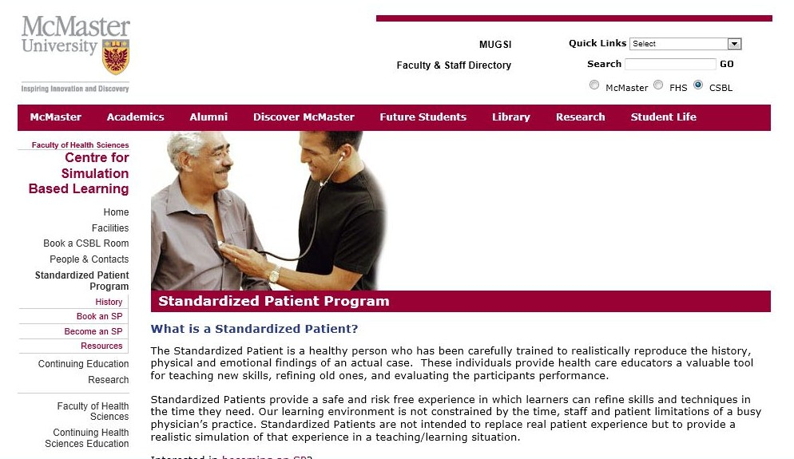
Standardized Patient Programs
Actors precisely duplicate the demeanor and symptoms of a patient.
Trained to answer spontaneous and unprepared-for questions.

Slide 4
Why Study Drama?
Traditional careers for Actors
The Actor’s skill-set (apart from talent)
Other careers utilizing the skills learned through the study of acting
The Internet and the future

Slide 5
Traditional ‘Acting’ Careers
Theatre / Stage Acting
Classical training
Theatre
Musical Theatre
Comedy
Dance and Choreography
Education / Training

Slide 6
Acting’ Careers
Film, Television, and Internet
Camera Acting :
Television
Film,
Independent Productions
Advertising
Educational videos
Voiceover Acting:
Advertising
Animated films and TV shows
Books-on-tape
other electronic media
Announcers and Hosts
TV Anchor
TV Reporter
TV Show Host
Radio Announcer
Radio News Announcer / Reporter
Comedy

Slide 7

Careers in Film, TV and Theatre
Director, Designer, Producer
Executive Producer
Program Director
Assistant Director
Director of Casting
Film Director / Editor
Other Careers in the Industry
Management
Press Agent
Theatrical Agent
Booking Agent
Literary Agent
Entertainment Critic
Teaching and Coaching
Publicity and promotion
Technical and Stage-set
Lighting, Audio, stage design and set-up.
Various film crew jobs
Script Writing

Slide 8
Getting an Agent
“Getting an agent is probably the single most
important thing a professional actor can do for
his/her career.”
‘Become an Actor,’ John C. Havens
Assembling a Professional Acting Package
Acting & Voice-over Demo Reel

Slide 9
Actor’s Skills
Transferrable Skills
Help build self-confidence, emotional awareness, and prepares students for dealing with a range of different situations and people

Slide 10
Actor’s Skills
Communication
Public Speaking
Interpersonal skills
Intrapersonal skills
Leadership
Problem solving skills
Improvisational skills
Time Management skills
IT skills
Communication
Verbal (and written) skills
Public Speaking: comfortableness in speaking to groups; conveying ideas to others; adapting to an audience

Slide 11
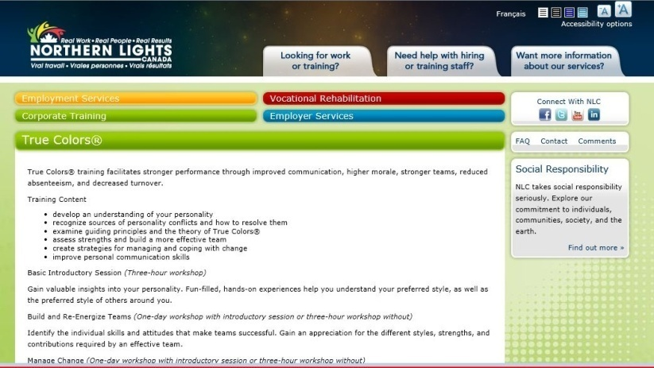
Corporate Training and Workshops
Corporations and companies often hold training sessions for their employees (to boost team spirit, morale, improve management skills, interpersonal skills, etc).
Often, actors are used to create scenarios on the topic of focus.
Eg. “Emotional Science Training, or “True Colours Personality Theory” a “model for understanding yourself and others based on your personality temperament.”
Actors work with employees to figure out their own personality type and how to deal with different personality types.

Slide 12
Actor’s Skills
Communication
Public Speaking
Intrapersonal skills
Interpersonal skills
Leadership
Problem solving skills
Improvisational skills
Time Management skills
IT skills
Intrapersonal skills:
self knowledge and self belief; emotional awareness
Interpersonal skills:
ability to work with others and in groups

Slide 13
Other Careers: ‘Actor’s Skills’
Interpersonal (People) Skills
communications and public relations
customer service representative
human resources
hospitality industry
management
mediators
social workers
Communications and Public Relations
Communications Officer
Public Relations Specialist
Media Relations Manager
Communications Manager
Corporate Affairs Specialist
Internal Communications Manager
Strategic Communications Manager
Public Relations Consultant
Corporate Communications Manager
Communications Director

Slide 14
Other Careers: ‘Actor’s Skills’
Sales
customer service representative
sales representative
Insurance or real-estate agents
marketing professionals
retail buyers
travel agents, tourism

Slide 15


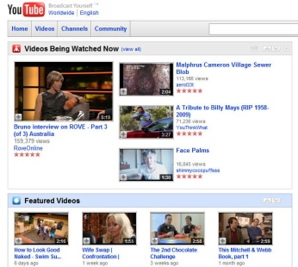






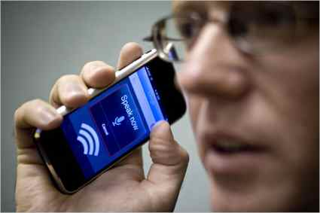

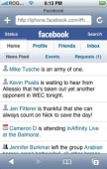
Web Content
Sales & Marketing

Slide 16

Web Content
Sales & Marketing

Slide 17

The Internet

Slide 18
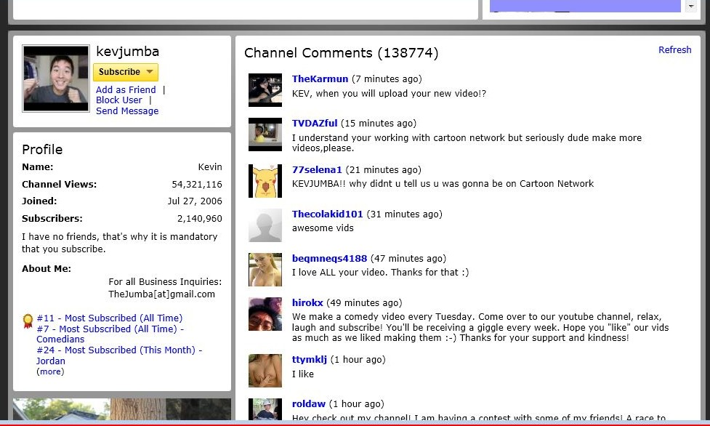
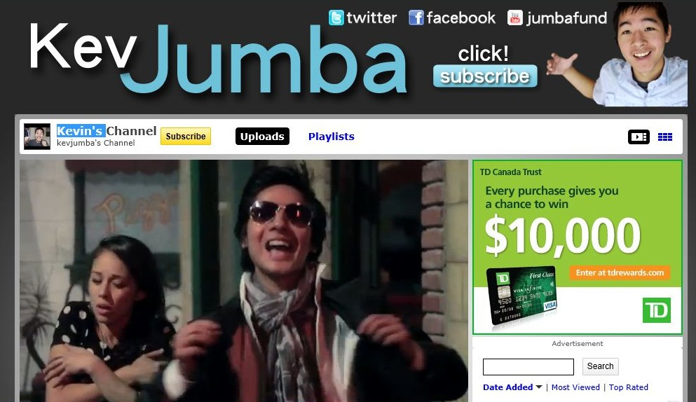
The Game has Changed

Slide 19


Slide 20
Network within the Youtube community to gain subscribers
Integration with Social Media : Facebook, Twitter, etc.
As traffic and subscribers increases, they can start generating Google Adsense revenue, and other revenue sources, such as:
Product placement - visual
Product endorsement – verbal (give ‘props’)
Website Referral – verbal or visual

Slide 21
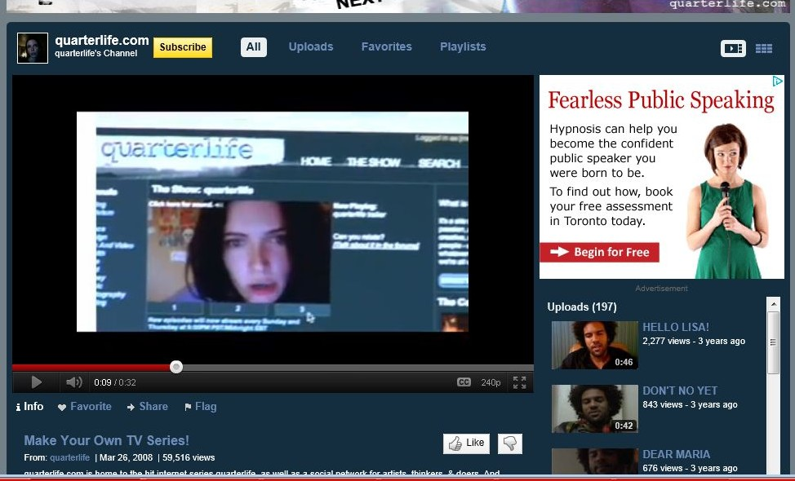
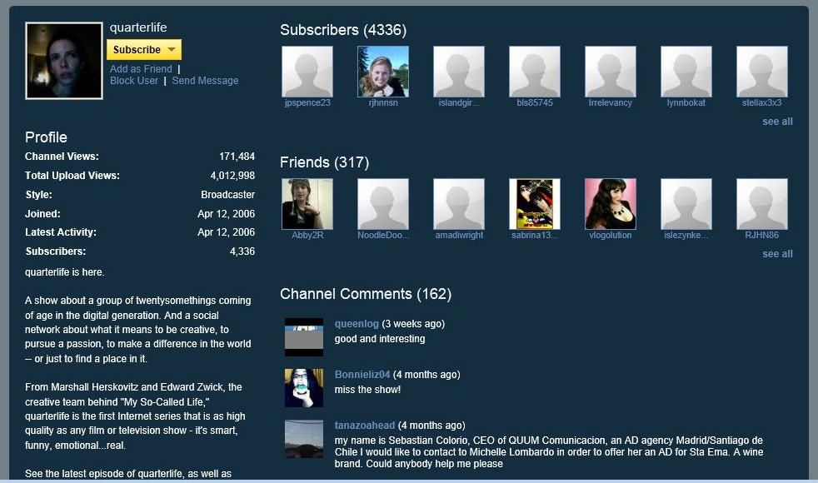
By-passing the broadcast networks
“Quarterlife”
Youtube channel
“TV show”

Slide 22

Film Production
Acting for Film Television and the Theatre
Writing for Film & Television

